Slide 1
Chapter 25 Magnetism
Magnet and Magnetic Field
Definition of Magnetic Field
Force on an Electric Charge Moving in a Magnetic Field
Torque on a Current Loop

Slide 2
New words and Expressions
magnetic monopole 磁单极
magnet 磁铁
north (south) pole 南(北)极
Cyclotron 回旋加速器
aurora borealis 极光
mass spectrometer 质谱仪
magnetic dipole moment 磁矩

Slide 3
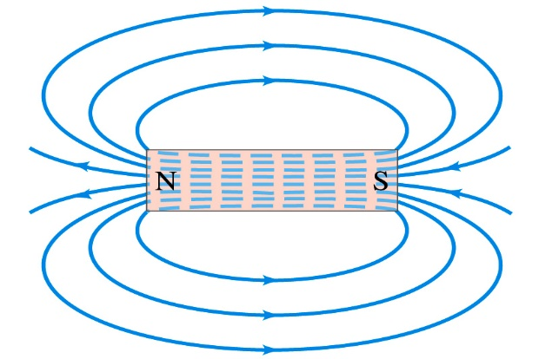
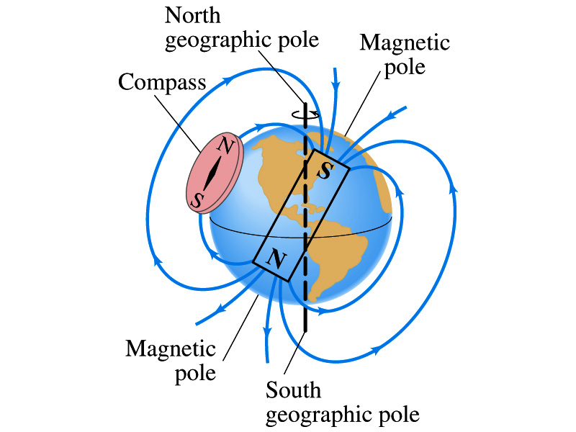
25-1.Magnets and Magnetic Fields (P580-582)
1 Magnetic phenomena
Magnets used in: Compass; refrigerator-door;
microphone; computer disk; …
I

Slide 4
2 Basic Concepts
Poles: the magnetic effect is strongest.
North (South) pole: The pole that points to geographic north (south).
北极
南极
There are force between poles.
Unlike poles attract, and like poles repel.

Slide 5
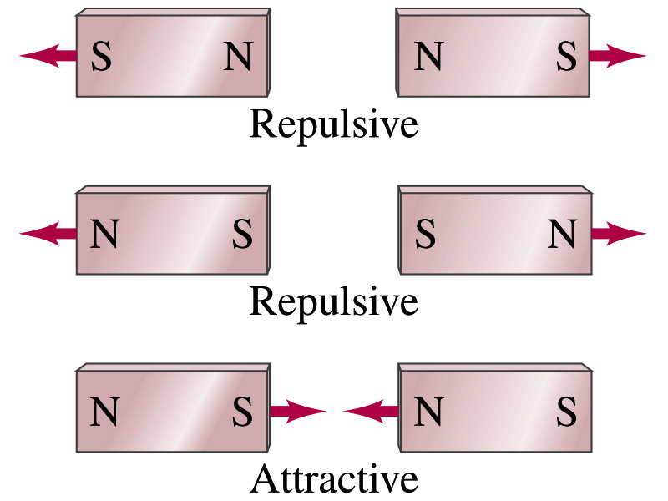
If you break a magnet in half, you don’t obtain isolated north and south poles; instead, two new magnets are produced. No magnetic monopole has been observed.

Slide 6
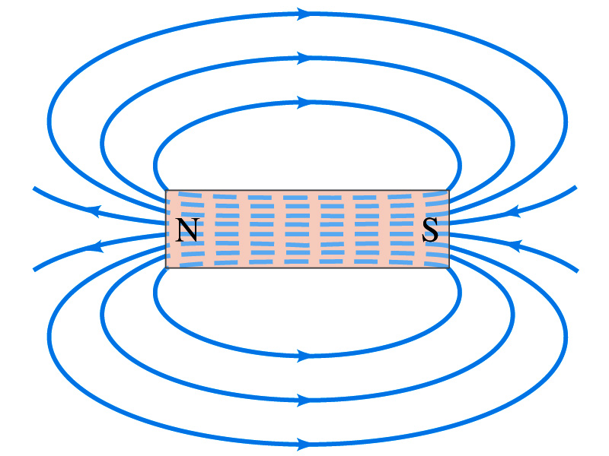
Magnetic field lines:
1) The direction of the magnetic field is tangent to a line at any point;
2) the number of lines per unit area is proportional to the
strength of the magnetic field.
3) Magnetic field lines form closed loops.

Slide 7
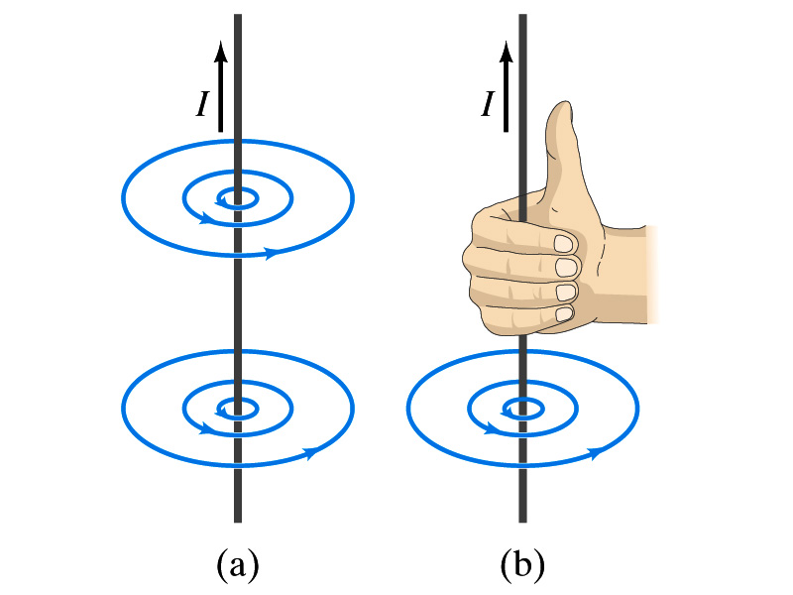
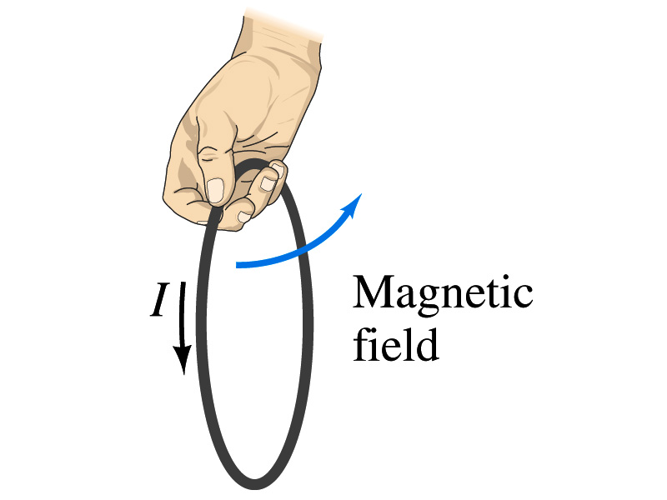
25-2. Electric Currents Produce Magnetism (P582-583)
In 1820, Oersted found an electric current produces a magnetic field.

Slide 8
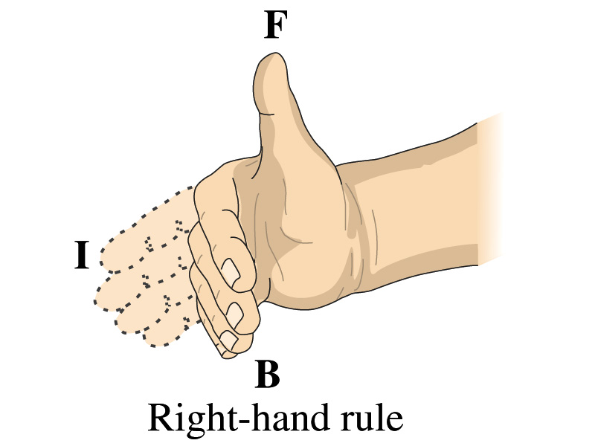
Right-hand-rule

Slide 9







25-3. Definition of Electric Field (P583-586)
运动电荷
磁场
运动电荷
1 Definition of
带电粒子在磁场中运动所受的力与运动方向有关.
+
+
实验发现带电粒子在磁场中沿某一特定直线方向运动时不受力，此直线方向与电荷无关.

Slide 10
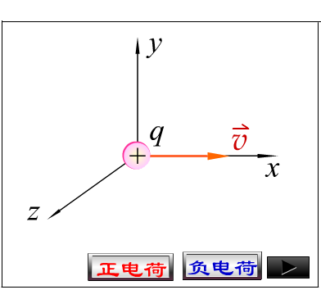
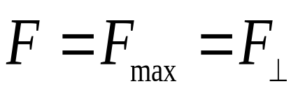
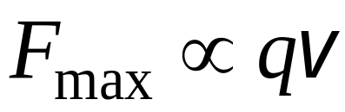
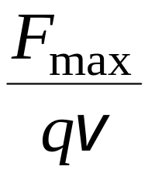
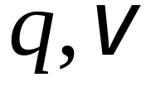
当带电粒子在磁场中垂直于此特定直线运动时受力最大.
大小与 无关

Slide 11
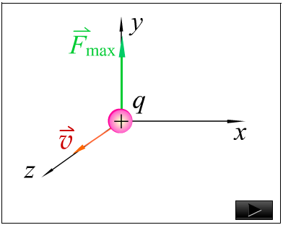

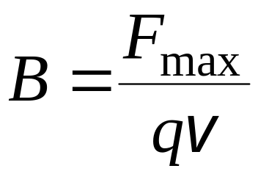
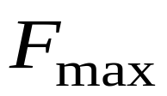
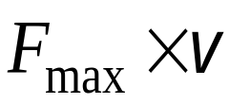
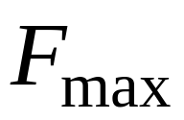



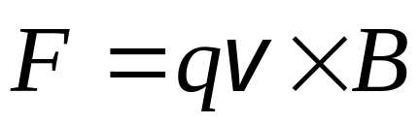
磁感强度 的定义：
磁感强度大小 magnitude
当正电荷垂直于特定直线运动
时，受力 , 将 方
向定义为该点的 的方向.
运动电荷在磁场中受力
+
—— Lorentz’s Force

Slide 12


2 Unit of Magnetic Field
单位 特斯拉
SI unit: Tesla (T), Gauss: G.
地磁场B_{earth} ≅ 5×10⁻⁵ T

Slide 13

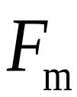
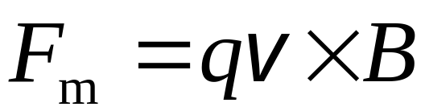

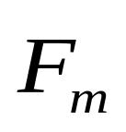







25-4. Force on an Electric Charge Moving in Magnetic Field (page 586-589）
1. Lorentz’s Force
Charges moving in magnetic field are acted by magnetic force:
The force acting on a charged particle moving
+
with velocity through a magnetic field is always perpendicular to and .

Slide 14
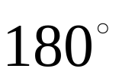
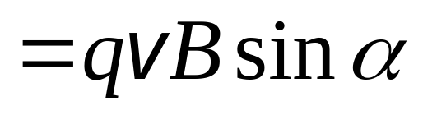

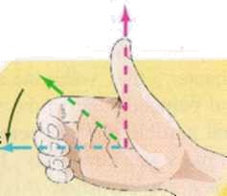

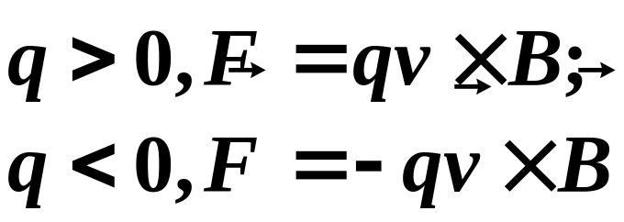

方向：即以右手四指 由经小于 的角弯向 ，拇指的指向就是正电荷所受洛仑兹力的方向.
α
q
When α = 0,F=0
Right hand rule
Magnetic force only change moving direction.
W_{B}=0

Slide 15





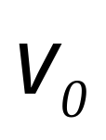
2. The Motion of Charged Particle in Uniform :
(1) Particle moves parallel to :
q
+
-
q
, particle straightly move in constant velocity.
(2) Particle moves perpendicular to :
Example 25-3: Magnetic force on a proton. An proton travels at in a plane perpendicular to magnetic field.

Slide 16
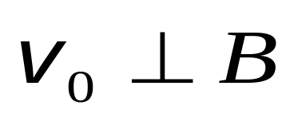
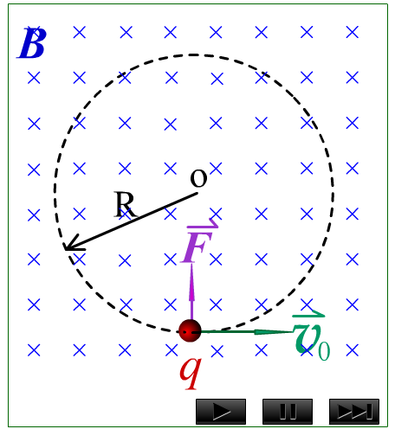
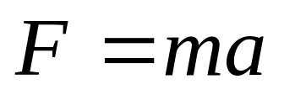
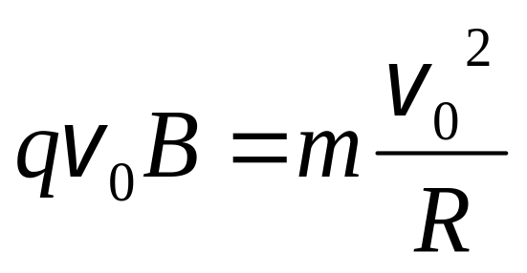
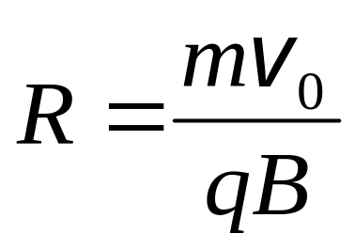
We solve for R and find

Slide 17
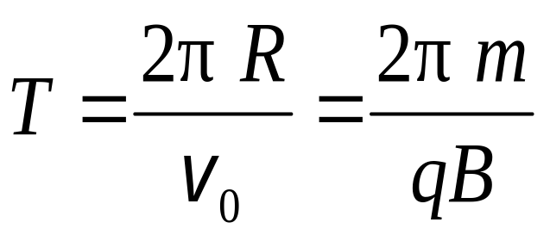
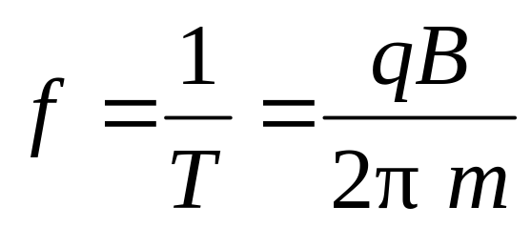
The time T (period of rotation) required for a particle of charge q moving with constant speed to make one circular revolution in a uniform magnetic field is:
The frequency of rotation is
是回旋加速器(cyclotron )的原理.

Slide 18

Note:
The frequency does not depend on the speed.
If speed is large, r is large for a given , but the
frequency is independent of and R.

Slide 19
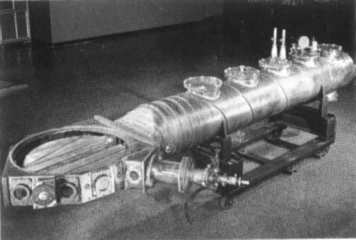
3. The application of particle moves in electric and magnetic field
1) Cyclotron 回旋加速器
1932年劳伦斯研制第一台回旋加速器的D型室.
此加速器可将质子和氘核加速到1MeV的能量，为此1939年劳伦斯获得诺贝尔物理学奖.

Slide 20
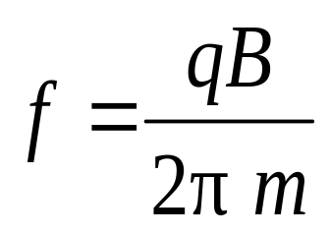
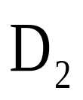
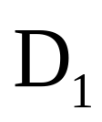
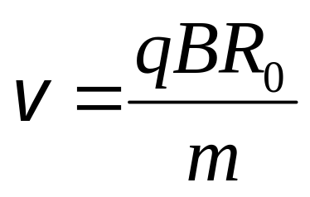
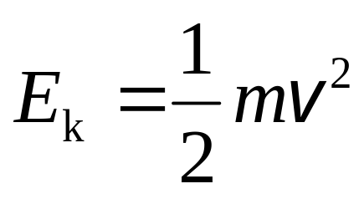
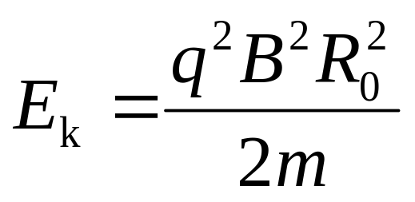
频率与半径无关
N
N
~
到半圆盒边缘时
O
B
S
回旋加速器原理图

Slide 21
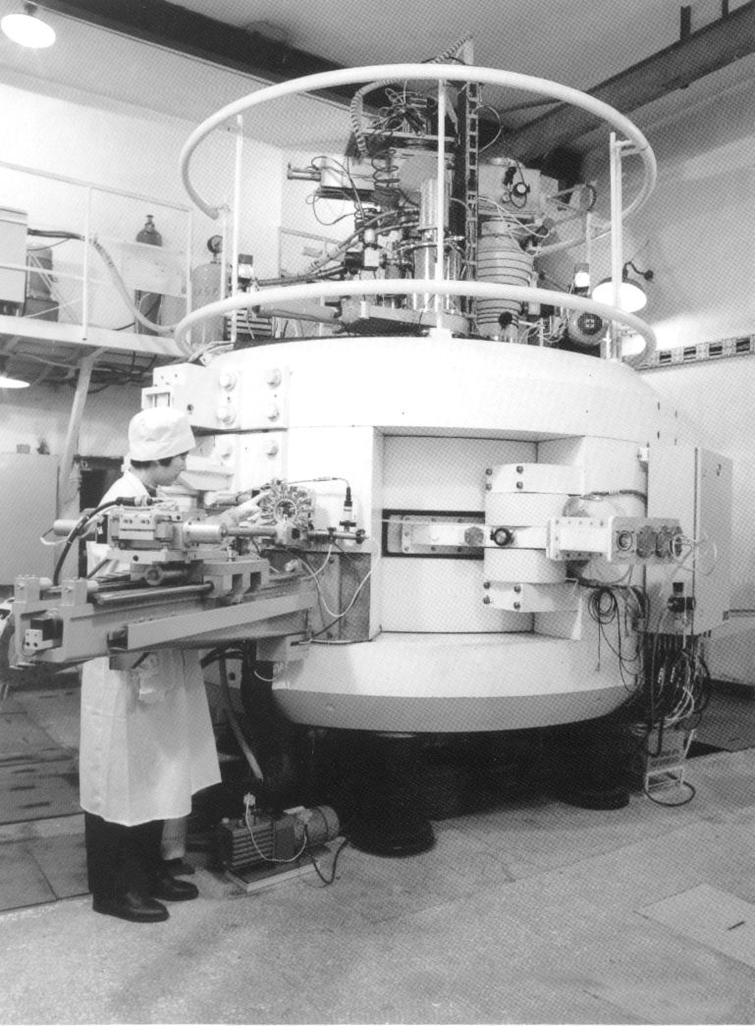
我国于1994年建成的第一台强流质子加速器 ，可产生数十种中短寿命放射性同位素 .

Slide 22
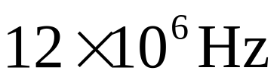
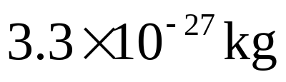
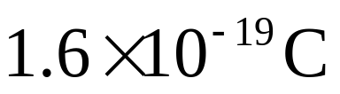
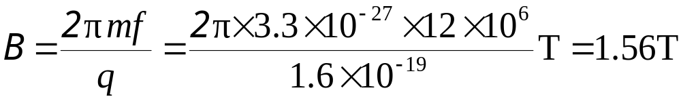
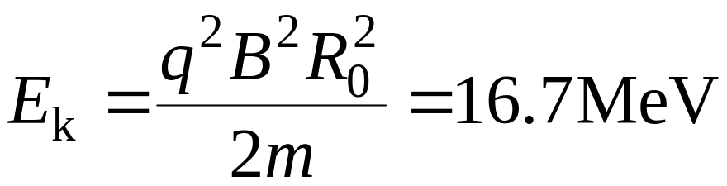
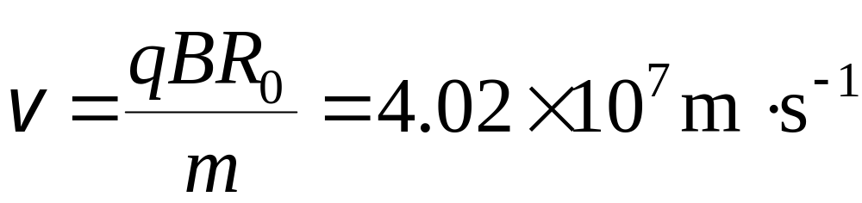
例 有一回旋加 速器，它 的交变 电压的 频率为 ，半圆形电极的半径为0.532m . 问 加速氘核所需的磁感应强度为多大？氘核所能达到的最大动能为多大？其最大速率有多大？（已知氘核的质量为 ，电荷为 ）.
解 由粒子的回旋频率公式，可得

Slide 23


2) Velocity selector, or filter: Crossed E and B fields. Example 25-7 Page 588电子比荷的测定
+
+
速度选择器
.
.
.
.
.
.
.
.
.
.
.
.
.
.
.
.
.
.
.
.
.
.
.
.
.
.
.
.
.
A
.
A’
.
.
.
.
.
.
.
.
.
.
.
.
.
.
.
.
.
.
.
.
.
.
.
.
.
.
.
.
.
.
.
.
.
.
.
.
.
.
.
.
.
.
.
.
.
.
.
.
.
.
.
.
.
.
.
.
.
.
.
.
.
.
.
.
.
.
.
.
.
.
.
.
.
.
.
.
.
.
.
.
.
K
.
.
.
.
.
.
.
-
L
d

Slide 24
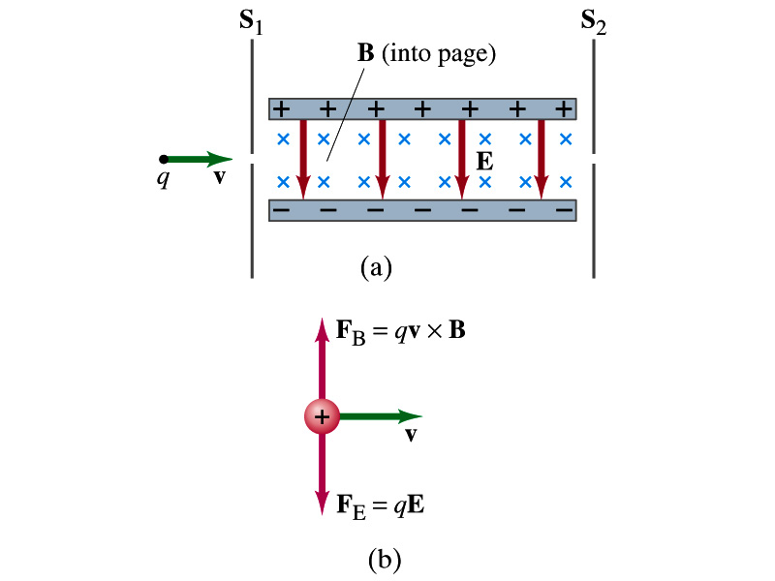
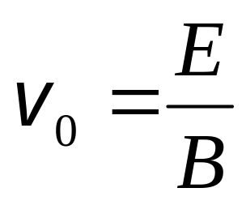
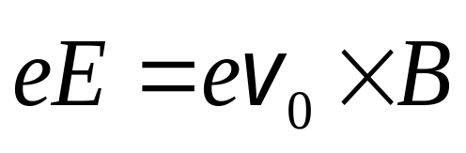

Slide 25
3) Aurora borealis. (northern lights)
Example 25-6 page 588: Aurora borealis
Charge ions approach the Earth from the Sun(the “solar wind”) and enter the atmosphere mainly near the pole, sometimes causing a phenomenon called the aurora borealis or northern lights in northern latitudes. Why toward the poles?

Slide 26

由于地磁场俘获带电粒子而出现的现象

Slide 27


绚丽多彩的极光
在地磁两极附近, 由于磁感线与地面垂直, 外层空间入射的带电粒子可直接射入高空大气层内, 它们和空气分子的碰撞产生的辐射就形成了极光.

Slide 28





4) Mass Spectrometer 质谱仪 P595-596
速度选择器
.
.
.
.
.
.
-
.
.
.
+
照相底片
.
.
.
.
.
.
.
.
.
.
.
.
.
.
.
.
.
.
.
.
.
.
.
.
.
.
.
.
.
.
.
.
.
.
.
.
70
72
73
74
76
.
.
.
.
.
.
.
.
.
.
.
.
.
.
.
.
.
.
.
.
.
.
质谱仪的示意图
锗的质谱

Slide 29









25-3 & 25-5. Force on an Electric Current in a Magnetic Field; Torque on a Current Loop, Magnetic Dipole Moment (P583-586, P589-591)
1. Magnetic force on a current
Freely choose a short length dl, cross area S, mass m, charge e, then the Lorentz’ force on each particle:
S
洛伦兹力

Slide 30






N=nS dl
S
where
安培定律 磁场对电流元的作用力
由于自由电子与晶格之间的相互作用，使导线在宏观上看起来受到了磁场的作用力 .

Slide 31














Note: where is external magnetic field.
意义 磁场对电流元作用的力 ，在数值上等于电流元 的大小 、电流元所在处的磁感强度 大小以及电流元和磁感应强度之间的夹角 的正弦之乘积 , 垂直于 和 所组成的平面, 且 与 同向 .
有限长载流导线所受的安培力

Slide 32





P599:11例 求如图不规则的平面载流导线在均匀磁场中所受的力，已知 和 .
A curved wire, connecting two points O and P, lies in a plane perpendicular to a uniform magnetic field and carries a current .
P
L
Show that the resultant magnetic force on the wire, no matter what its shape, is the same as that on a straight wire connecting the two points carrying the same current .

Slide 33








解 取一段电流元
P
L
结论 任意平面载流导线在均匀磁场中所受的力 , 与其始点和终点相同的载流直导线所受的磁场力相同.

Slide 34
(1) The sum of magnetic force acted on a whole curved wire = the one of straight wire with same current connected from start to end points.
(2) If points O and P overlapping, then l=0, F=0.
No magnetic force exerted on a current loop in a uniform magnetic field. (均匀磁场中任意闭合导线所受的磁场力=0)
(3) Magnetic force is always perpendicular to the plane defined by length vector and magnetic field.

Slide 35













2. Torque (力矩) on a Current Loop :P589-590
如图 均匀磁场中有一矩形载流线圈MNOP
P
Magnetic force exerts on a current loop
M
I
O
N
O,P
M,N

Slide 36



P
O,P
M
I
O
M,N
N
Torque:

Slide 37



Introducing the magnetic dipole moment of the coil (线圈的磁矩). It is considered a vector:
The direction of is perpendicular to the plane of the coil consistent with the right-hand rule
This formula, derived here for a rectangular coil, is valid for any shape of flat coil.

Slide 38

Example: 36 on page 601
A 20-loop circular coil 20 cm in diameter lies in the xy plane. The current in each loop of the coil is 7.6A clockwise, and an external magnetic field
T passes through the coil.
Determine:
a) the magnetic moment of the coil;
b) The torque on the coil due to the external magnetic field.

Slide 39


Slide 40
Homework 8: P599-603
8, 14, 20, 27

